Slide 1

Elements related to credit credibility
Temuulen Murun, Researcher, Climate and Energy Area
Kentaro Takahashi, Deputy Director, Climate and Energy Area

Slide 2
Outline
Criticisms of offset credits (global level)
What elements affect high-quality carbon credit?
Literature review on credit credibility
Highlight of some elements related to credit credibility
Summary

Slide 3
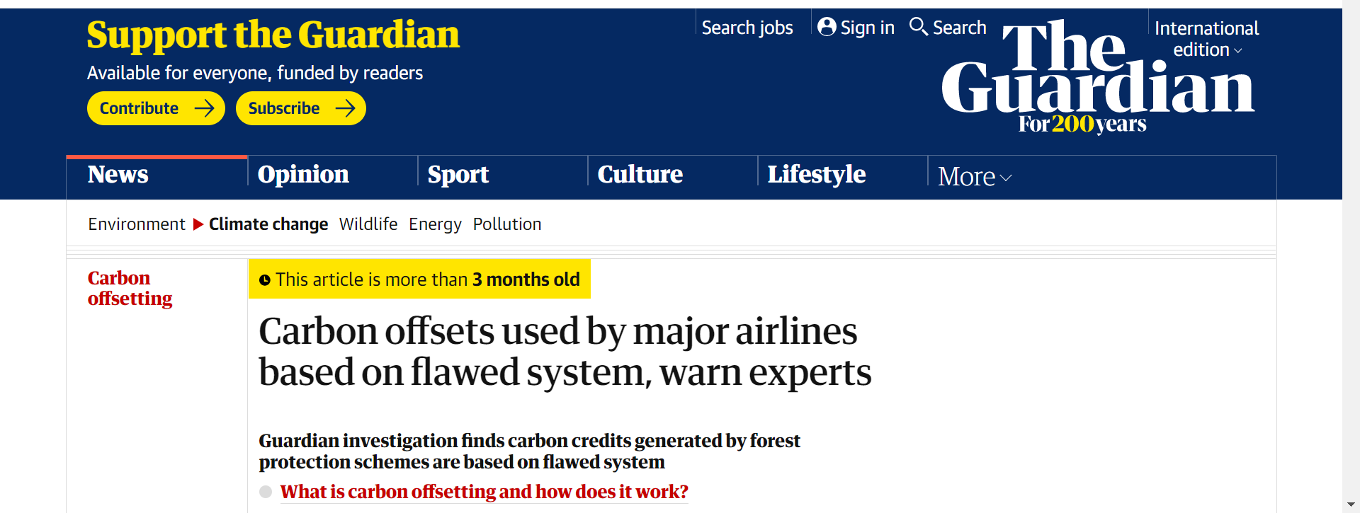
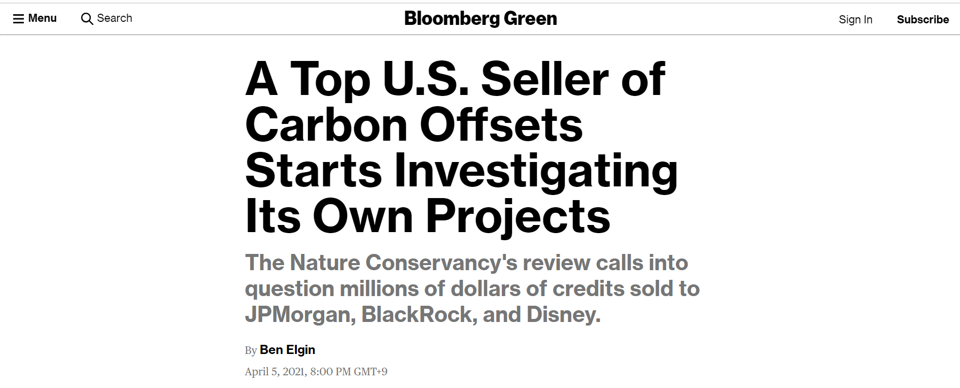
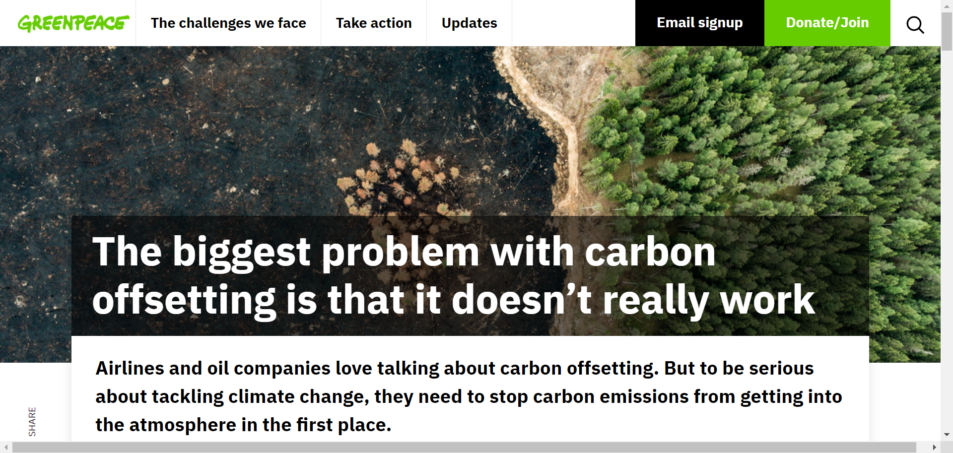
Criticisms of offset credits
Greenwashing, lowering environmental integrity, undermining Paris Agreement (PA) 1.5C target and business climate actions
  Methodologies in forest projects are not robust enough (Guardian, UK)
  Selling credits for well-protected trees undermines sustainability (Bloomberg, USA)
  Offset credits can be used as a substitute for real climate actions (Greenpeace, UK)
  Carbon offsets have been used by polluters as a free pass for inaction (UNEP)
*UNEP: United Nations Environment Programme

Slide 4
High-quality carbon credits (credit credibility)
What elements affect high-quality carbon credits? What is credit credibility? Which credits can we trust?
- GHG reductions must be real, quantifiable and verifiable
Must be additional and permanent CO₂ emission reductions/removals
Should come from projects that do not contribute to environmental and social harm
Table 1. Some analyses on credit credibility
EDF, WWF, and Oeko Institut (Objectives and criteria) (Jun 2020) | SEI and GHG Management Institute (Criteria) (Nov 2019) | WRI (Concerns on supply-side) (Feb 2021)
Robust determination of the GHG emissions impact of the mitigation activity | Additional | Additionality
Avoiding double counting of emission reductions or removals | Not claimed by another entity | Measurement and uncertainty
Addressing non-permanence | Permanent | Permanence
Facilitating transition towards net zero emissions | Not-overestimated | Leakage
Strong institutional arrangements and processes of the crediting programme
Enhancing positive and preventing negative environmental and social impacts | Not associated with significant environmental and social harm | No harm to local ecosystem and local community
*EDF: Environmental Defense Fund, WWF: World Wide Fund for Nature, SEI: Stockholm Environment Institute, WRI: World Resources Institute

Slide 5
Results from literature review
Literature review:
Review on credit credibility analyses done by EDF, WWF, Oeko Institut, SEI, GHG Management Institute, WRI, international scheme (CORSIA), reports from other international organisations (WB, SBTi/CDP), international initiatives (TSVCM, VCMI)
Why did we conduct this? The growing demand and the risks associated with low-quality carbon credits. Critical for credits buyers to identify credible credits (high-quality carbon credits) to use for offsetting
Table 2. Result of the review on the elements related to credit credibility
Elements | Note
1. Additionality | An essential criterion for determining their quality. How to assess additionality?
2. Baseline scenario in methodology | Developing a conservative and realistic baseline in methodology to calculate GHG emission reduction
3. Robust MRV system | A third party entity involvement for validation and verification
4. Avoidance of double counting | Avoiding double issuance, use, claim which involves rules under Article 6 of the Paris Agreement (applying corresponding adjustments: CAs)
5. Permanence | The risk of reversing stored carbon in Nature-based Solutions (NbS)
6. Social and environmental safeguards (Negative impacts) | Avoiding negative impacts on society (local community, indigenous people) and environment (changing natural landscape)
7. Contributing to SDGs (Positive impacts) | SDGs and NbS cover both mitigation and adaptation projects that have more potential than reducing GHG emissions
8. Governance and Transparency | Governance should be transparent including public participation and committees with experts/professionals
*CORSIA: Carbon Offsetting and Reduction Scheme for International Aviation, WB: World Bank, SBTi: Science Based Target Initiative, CDP: Carbon Disclosure Project, TSVCM: Taskforce on Scaling Voluntary Carbon Markets, and VCMI: Voluntary Carbon Market Initiative, MRV: measurement, reporting, verification

Slide 6
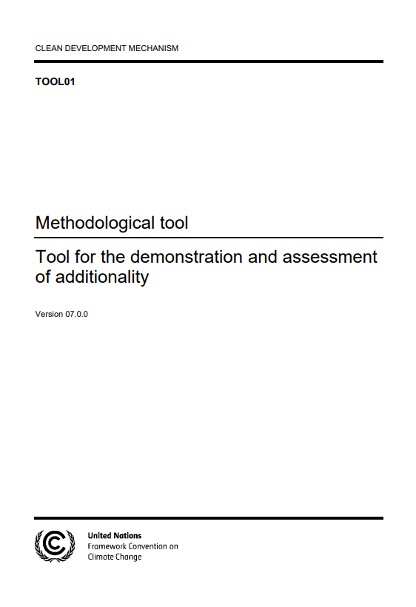

1. Additionality
What is additionality?
Additionality is a concept to assure the implementation of a project will secure GHG emission reductions rather than not being implemented.
What is the risk of additionality?
Potential risk that emission reductions may not have actually occurred
How to secure additionality?
A regulatory surplus test: to demonstrate the project is legally required
A financial or investment test: to analyse the project is financially attractive in the absence of offset credit revenues
A common practice test: to demonstrate how the project is distinct from similar types of activities
Tool for the demonstration and
assessment of additionality
Number of CDM registered project which demonstrated the additionality※
6,286
※Some small scale and micro-scale projects under the CDM have not been required to explain the additionality.

Slide 7
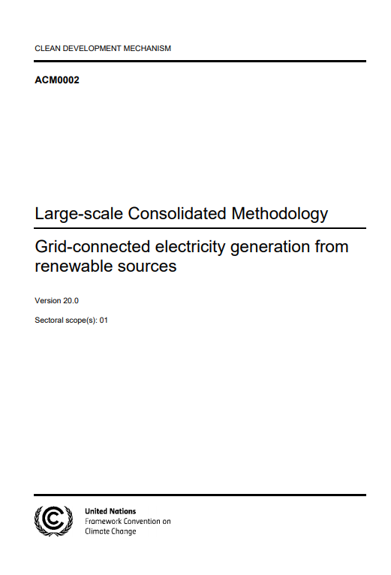
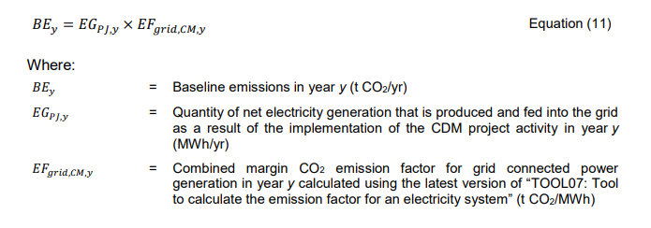



2. Baseline setting
What is a baseline?
Baseline emissions are GHG emissions that would occur in the absence of the proposed project activity.
Project emission reductions = Baseline emissions – Project emissions
What is the risk related to this?
Overestimation of GHG emission reductions, which leads to over-crediting
How can it be avoided?
Conservative baseline setting
Revise baseline scenario regularly in an appropriate timing
(see Annex)
CDM sample：ACM0002
（methodology for renewable energy）
Num of approved methodologies
(as of 18 August 2021)
219
43
16
Baseline settings are also discussed in negotiations under Article 6 of the Paris Agreement. In particular, Article 6.4 which is the mechanism of the successor to CDM, considers multiple approaches for baseline setting.
3

Slide 8
3. Permanence
What is permanence?
  Carbon credits need to represent emission reductions/removals that are effectively permanent. If emission reductions/removals are reversed, then credits no longer serve a compensatory function.
What is the risk related to this?
  The risk of non-permanence occurs with projects that store carbon (e.g. forestry projects affected by natural disaster).
  If all of the stored carbon can be re-emitted into the atmosphere, the credits have no value to represent GHG emission reductions/removals.
How can it be avoided?
  Buffer pool account: Carbon credits from individual projects are set into a buffer pool account, which functions as an insurance mechanism.

Slide 9
4. Double counting
What is double counting?
  Double issuance: one carbon credit is issued more than once for the same emissions reductions
  Double use: the same credit is counted twice for achieving climate change mitigation
  Double claim: two different entities claim the same emission reductions
What is the risk related to this?
  Can undermine the integrity of crediting mechanisms and carbon credits
  Risk of double claiming with countries’ climate change mitigation under the PA (whether to apply CAs on voluntary carbon markets)
How can it be avoided?
  Registry system should use serial numbers to record and transparently track carbon credits to ensure that only one credit is issued per emission reduction
  Example on avoidance of double claiming considering CAs in crediting programmes:
    - to identify in which year and in which country the emission reductions occurred
    - to ensure that authorisations for CAs are in a host country etc.
    (EDF, WWF, and Oeko Institut, 2020) (see Annex)
*CA: Corresponding Adjustment

Slide 10
5. Negative and Positive impacts
What are the impacts?
  Negative impacts: should not significantly contribute to social and environmental harm
  Positive impacts: should generate impacts beyond GHG emission reduction. This could include environmental, social, and economic impacts (SDGs, benefits from NbS).
What is the risk related to this?
  Over-claiming positive impacts (greenwashing) from projects that have not followed safeguards and local stakeholder participation
How can it be avoided?
  Should include environmental and social safeguarding rules that ensure identifying and mitigating any harms.
  Should create an approach to assess development benefits such as contributions to SDGs and positive impacts from NbS (e.g. Gold Standard, at least 3 SDGs, SDG Impact tool)
  (see Annex)
*NbS: Natural-based Solutions

Slide 11
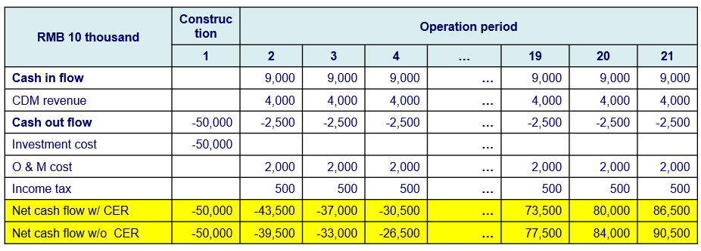
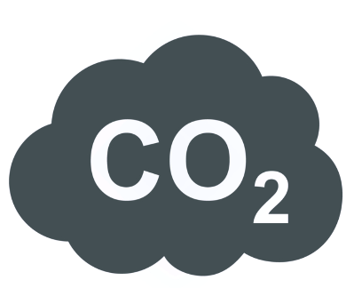

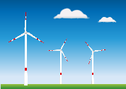

1. Additionality: Investment Analysis in the CDM (example)
Benchmark Analysis
11%
Revenue
by selling
credit
Benchmark
Rate
10%
Revenue
by project
8%
Revenue
by project
Project IRR
without credit revenue
（in the absence of CDM）
Project IRR
with credit revenue
（in the CDM）
*IRR: Internal Rate of Return
In the CDM, a proposed project explains that it will not be profitable without the sale of credits when demonstrates the proposed CDM project is an additional.
Question is "Is renewable energy project an additional in the future?"
Number of CDM registered project which demonstrated the additionality (Source: IGES CDM Project Database)

Slide 12
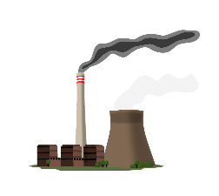

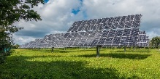
2. Baseline setting: Renewable energy project (example)
0.846tCO₂/MWh
(EF published by government (MONRE)）
*MONRE: Ministry of Natural Resources and Environment
Emission
Baseline Emission
EF based on the current and future energy mix (coal and natural gas etc)
0.333tCO₂/MWh
（EF in the approved methodology (JCM in Viet Nam))
Conservative Baseline Emission
（JCM defines it as reference emissions）
EF based on the energy mix (only natural gas)
Emission Reduction
（Credit）
Project Emission (PE)
In case of renewable energy, PE = zero
Emission reduction (ER) will be different depending on the selection of EF
(In case of 100,000 MWh solar PV) ER Difference: 51,000tCO₂ /year （510,000tCO₂ (10 years)）
year
In the future, as natural gas and renewable energy become widespread, how to set the baseline (especially the emission factor (EF)) is one of the important elements in the conservative baseline setting.

Slide 13
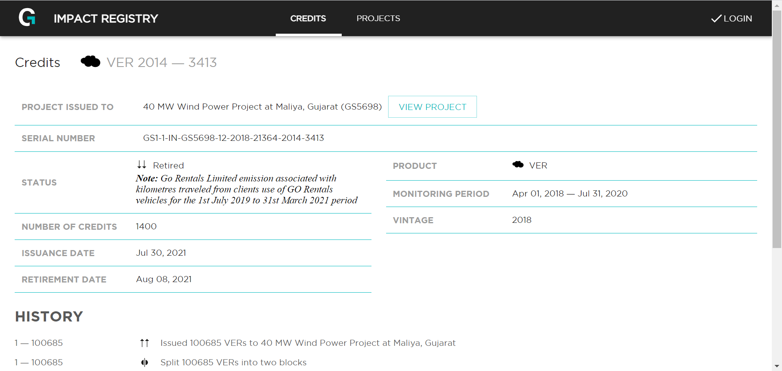
4. Double counting: Gold Standard/ART (example)
Transparent registry system allows public to see all recordings on credits (issued, transferred, cancelled, retired) and includes the relevant documentations for each project.
Serial numbers:
GS1-1-IN-GS5698-12-2018-21364-2014-3413:
IN | Indonesia (Country code)
GS5698 | Project ID
12 | Project ID
2018 | Vintage of credits
21364 | Batch number of the issuance
2014-3413 | Serial range of the credits
(Gold Standard, Impact Registry)
Avoiding double claiming: Application of CAs in ART Programme
(The REDD+ Environmental Excellence Standard (TREES):
To prevent double claiming by the host country and a private company for use toward mitigation obligations, TREES requires that the host country issue a letter to authorise the use of the specific emission reduction by buyers (private companies). The letter will be posted publicly on the ART registry (ART, 2020).

Slide 14

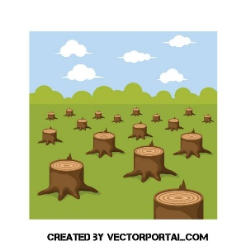
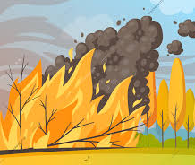
3. Permanence: VERRA (example)
Verified Carbon Standard: any risk related to permanence in projects is addressed through the Non-Permanence Risk Tool, to determine how many credits to be deposited in the buffer pool account.
Non-Permanence Risk Tool has three categories: internal risks, external risks and natural risks, and divided into sub-categories such as project management, financial viability and community engagement etc.
Project develops a non-permanence risk report based on the risk tool, which is assessed by the validation and verification bodies.
Example:
Project A:
100 buffer credits
Buffer pool account
Release 100 buffer credits
Project B:
250 buffer credits
Project C:
200 buffer credits
Release 150 buffer credits
*VERRA: Independent crediting program, founded in 2007, for assuring high quality of voluntary carbon markets.

Slide 15
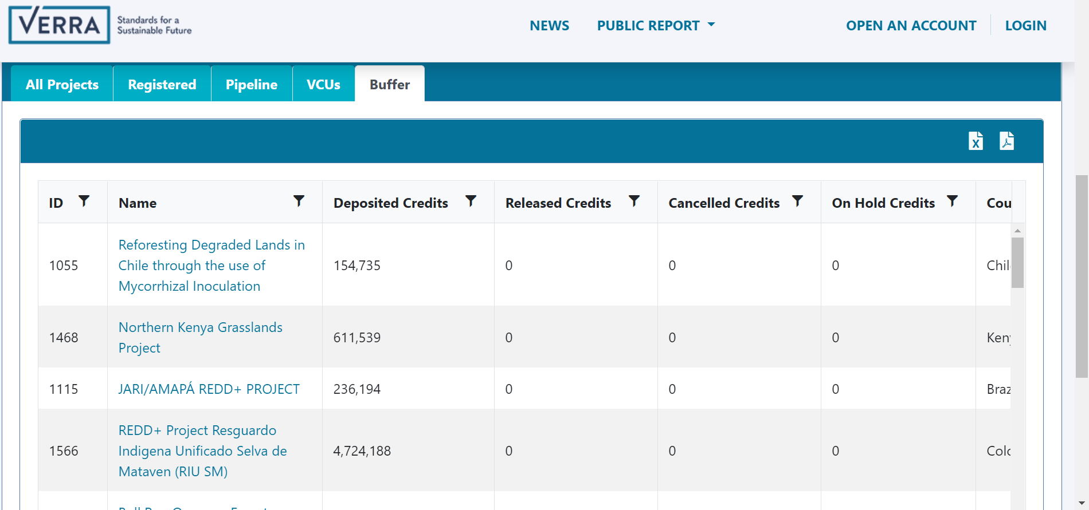
VERRA registry system: Buffer credits

Slide 16
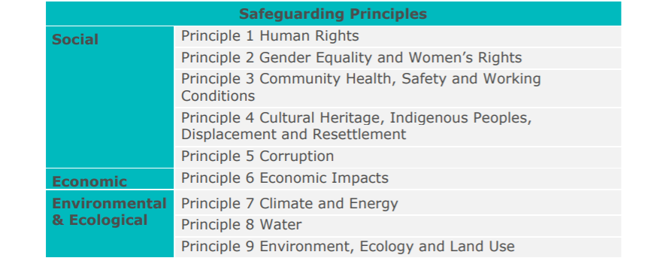
5. Negative impacts: Gold Standard (example)
Safeguarding principles: All projects shall undertake assessment against 9 principles and implement their project in accordance with requirements.
The project shall not directly or indirectly reinforce gender-based discrimination
The project shall avoid adverse impacts on the health and safety of communities during the projects life cycle
The projects shall consider economic impacts and potential risks to the local economy
Projects participants conduct the assessment for these principles based on formulated questions and implement stakeholder consultation to get feedback and review.

Slide 17
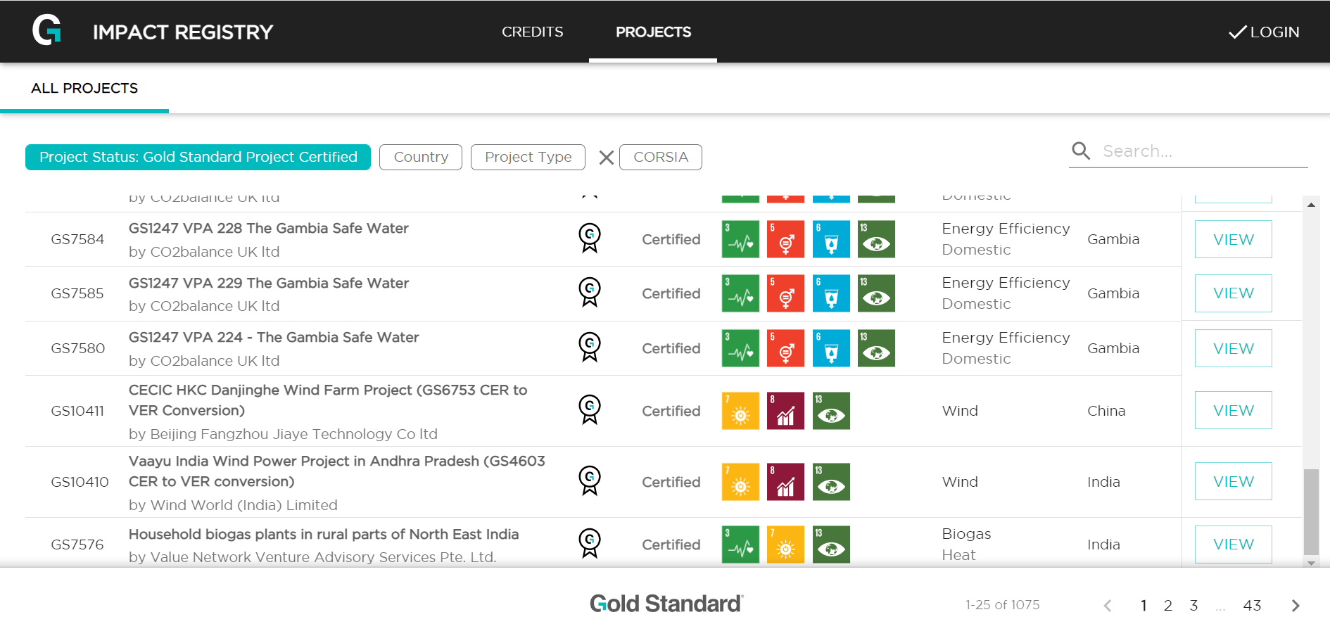
5. Positive impacts: Gold Standard (example)
SDG impacts: All projects shall demonstrate a clear, direct contribution to sustainable development and positive impacts on at least 3 SDGs, one of which must be SDG 13.
“Gambia safe water” project supports the provision of safe water to households using borehole technology.
SDG 3, SDG 5, SDG 6, SDG 13
Example in SDG 6: Quality of Treated Water based on Gambian national standards
To demonstrate SDG impacts in project documentation, including a monitoring & reporting plan, the project may choose one of the following options:
Option 1: A project developer shall review the UN SDG Targets and Indicators and select the most relevant targets and indicators to the chosen three SDGs and demonstrate how the project has positive impacts
Option 2: Follow a Gold Standard Approved SDG tool for the demonstration of SDG Impacts (SDGs tool guidance)
Option 3: Follow a Gold Standard Approved Methodology (SDG impact quantification methodologies)

Slide 18
Summary (Key messages)
Carbon offsets should not undermine ambition of corporate emission reductions and need to align with PA 1.5 target
Buyers need to be careful about what kind of offset credits they purchase and which elements are required to ensure credibility (high-quality)
Elements related to credit credibility: Additionality, Baseline scenario, Robust MRV, Permanence, Avoidance of double counting, Negative and Positive impacts, Governance and Transparency
Independent crediting programmes have adjusted their rules and guidelines to align with international discussions on PA Article 6, Net-zero and SDGs
Moving forward, we need to closely watch discussions on COP26 Article 6 negotiations, TSVCM, VCMI (and SBTi reports on Net-zero strategy)

Slide 19
Reference
Bloomberg, 2021, https://www.bloomberg.com/news/features/2021-04-05/a-top-u-s-seller-of-carbon-offsets-starts-investigating-its-own-projects
Guardian, 2021, https://www.theguardian.com/environment/2021/may/04/carbon-offsets-used-by-major-airlines-based-on-flawed-system-warn-experts
Greenpeace, 2020, https://www.greenpeace.org.uk/news/the-biggest-problem-with-carbon-offsetting-is-that-it-doesnt-really-work/
Greenpeace, 2021, https://www.greenpeace.org.uk/news/airlines-carbon-offsets-solution-climate-change-wrong/
UNEP, 2019, https://www.unep.org/news-and-stories/story/carbon-offsets-are-not-our-get-out-jail-free-card
EDF, WWF, and Oko institut, 2020, https://www.worldwildlife.org/publications/what-makes-a-high-quality-carbon-credit
SEI and GHG management institute, 2019, http://www.offsetguide.org/wp-content/uploads/2020/03/Carbon-Offset-Guide_3122020.pdf
WRI, 2021, https://www.wri.org/research/consideration-nature-based-solutions-offsets-corporate-climate-change-mitigation
CORSIA, 2019, https://www.icao.int/environmental-protection/CORSIA/Documents/ICAO_Document_09.pdf
VERRA, VCS guidance 4.1, 2021, https://verra.org/vcs-standard-v4-1-will-scale-up-finance-for-climate-mitigation/
WB, 2021, https://openknowledge.worldbank.org/handle/10986/35271
TSVCM, 2021, https://www.iif.com/Portals/1/Files/TSVCM_Phase_2_Report.pdf
VERRA, Non-Permenance risk tool, 2019, https://verra.org/wp-content/uploads/2019/09/AFOLU_Non-Permanence_Risk-Tool_v4.0.pdf
VERRA, Registry system, https://registry.verra.org/app/search/VCS
Gold Standard, Safeguarding principles, 2019, https://globalgoals.goldstandard.org/103-par-safeguarding-principles-requirements/
Gold Standard, SDG impact quantification methodologies, 2018, https://globalgoals.goldstandard.org/400-sdg-impact-quantification/
IGES, 2021, IGES CDM project database, https://www.iges.or.jp/jp/pub/iges-cdm-project-database/en
Gold Standard, Impact registry, https://registry.goldstandard.org/credit-blocks?q=&page=1
ART, 2020, The REDD+ Environmental Excellence Standard, https://www.artredd.org/wp-content/uploads/2020/04/TREES-v1-February-2020-FINAL.pdf

Slide 20

Thank you for your attention
Temuulen Murun,
Researcher, Climate and Energy Area (murun@iges.or.jp)
Kentaro Takahashi
Deputy Director, Climate and Energy Area

