Slide 1
WSDS/Thematic track
Promoting environmentally sound technologies and best practices
(New Delhi, 15 Feb. 2018 - 13:30 - 15:30)
IGES-TERI efforts to promote environmentally sound technologies deployment in India
Abdessalem RABHI, PhD.
Programme Manager, IGES

Slide 2
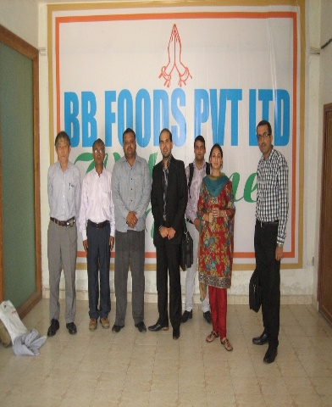
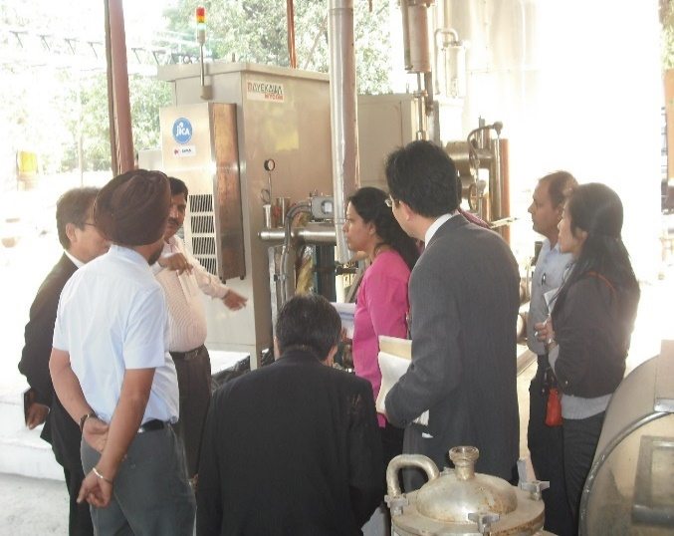
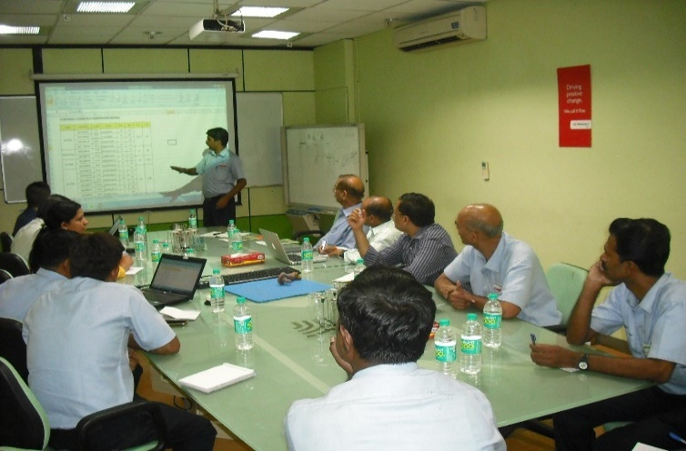
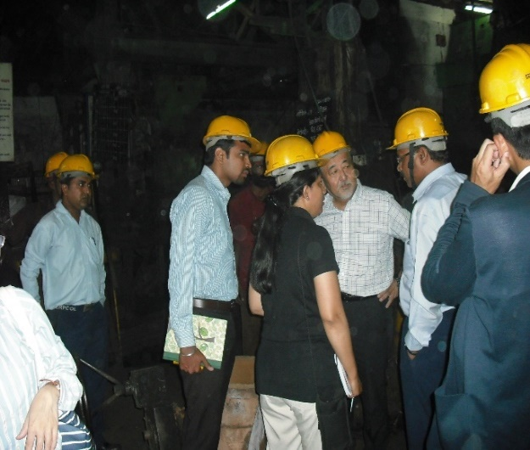
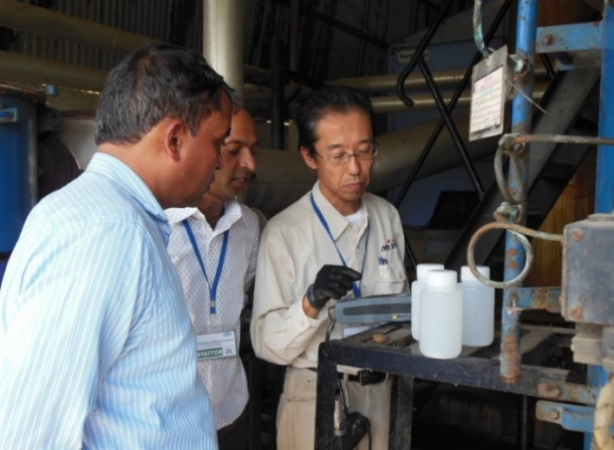
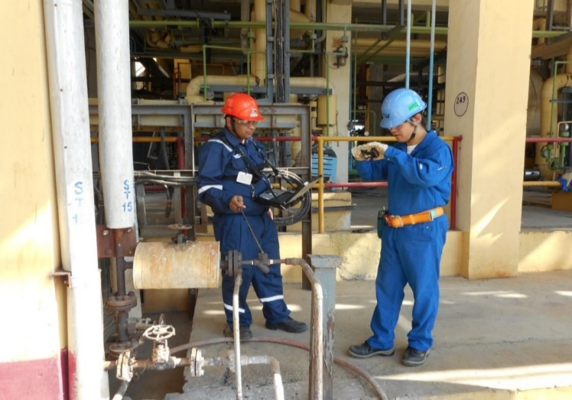
B2B Matching: Feasibility studies
FS on Gas Heat Pump (GHP)
FS on Electric Heat Pump (EHP)
FS on Compressed air (CA)
FS on Induction Furnace (IF)
FS on Once Through Boiler (OTB)
FS on Steam System Optimization (SSO)

Slide 3
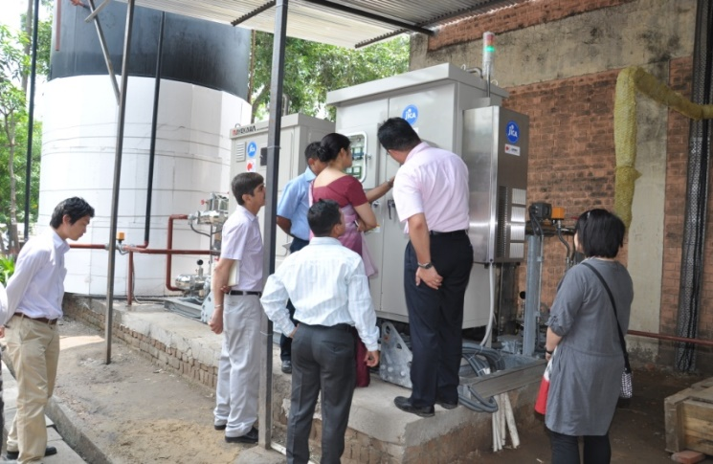
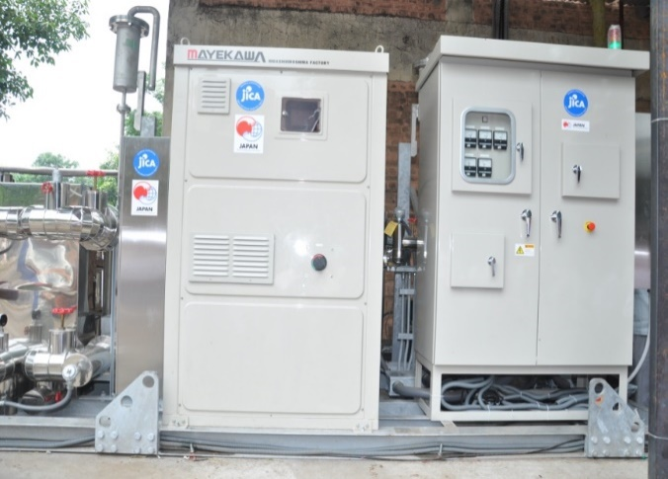
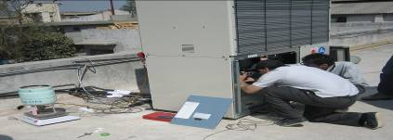
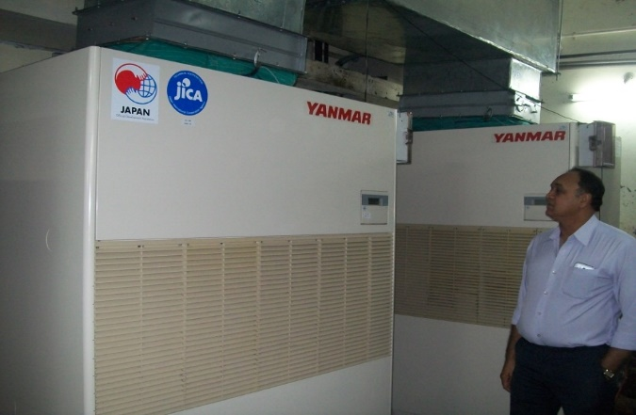
B2B Matching: Demonstration projects and impact evaluation
Electric Heat Pump (EHP): 30%-40% energy saving due to reduction in fuel consumption of boiler and electricity consumption of chiller
Gas Heat Pump (GHP): 35%-45% energy saving due to switch from electricity to Natural Gas as source of energy

Slide 4
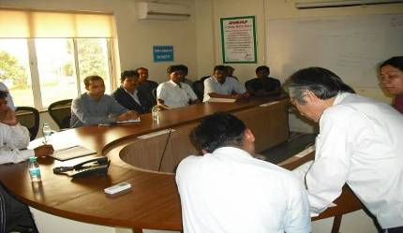
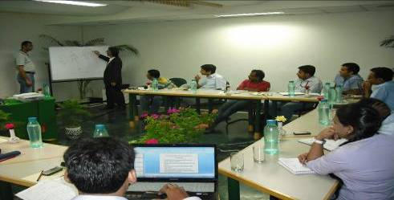
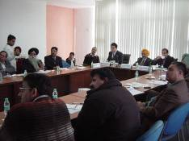
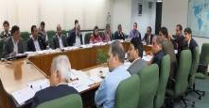
B2B Matching: Awareness creation and capacity building
On site trainings for plant engineers
In house trainings for energy auditors (TOT)
Awareness creation and capacity buildings for businesses managers and/or owners
Notes:
4

Slide 5
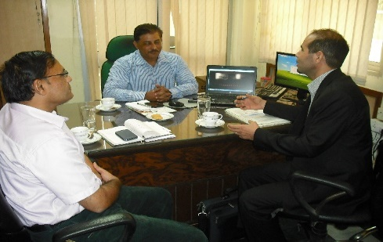
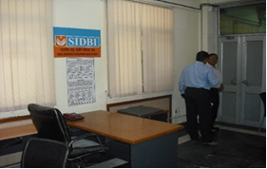
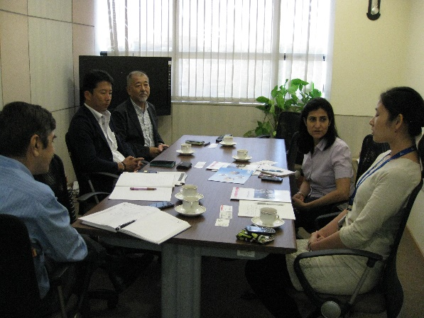
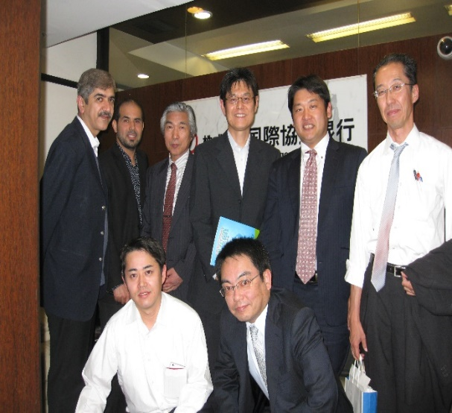
B2F Matching: Explore potential financing options
Mtg. with Small Industries development bank in India (SIDBI)
Mtg. with JICA (India)
Mtg. with JBIC (India)

Slide 6
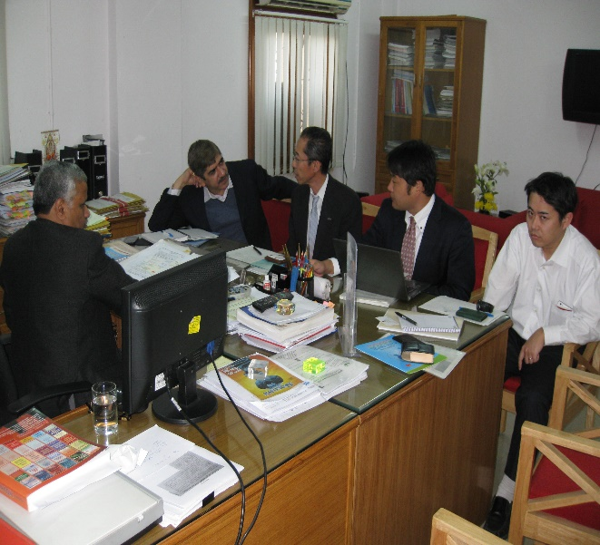
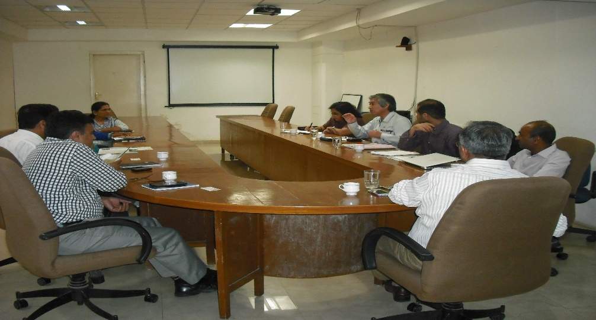
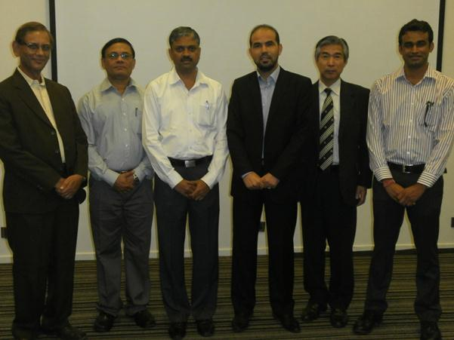
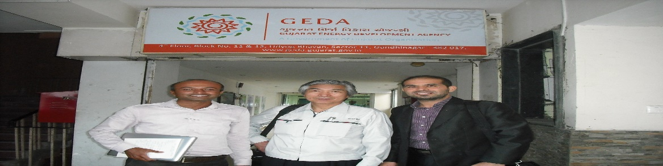
B2P Matching: Explore supporting policy/programme options
e.g. mtg. with Central Boiler Inspectors regarding IBR
e.g. Mtg. with Gujarat Energy Development Agency (GEDA)
e.g. mtg. with MCCIA, MEDA and SHAKTI foundation

Slide 7
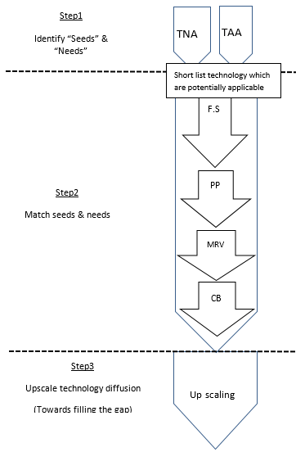
In brief: The whole technology transfer process is addressed, while creating synergy among efforts/projects
Technology Need Assessment (TNA)
Technology Availability Assessment (TAA)
Feasibility Study
JICA/JST project)
(FY2010-2013)
MOEJ Projects
(FY2014, FY2015-2017)
Demonstration projects
Evaluation
Capacity Building

Slide 8
Emission reduction from EHP demonstration project:
-Average CO2 reduction is 180 ton/year
Notes:
Note: In Year 2013, EHP started operation in 23 Jul.
Year 2015, EHP was under breakdown for 4 months
Year 2017, the data was just until Mid July.

Slide 9
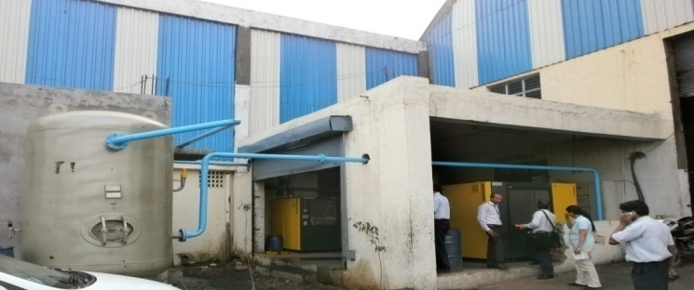
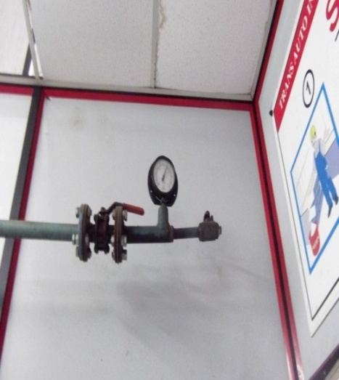
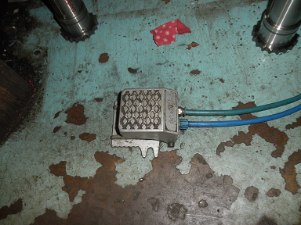
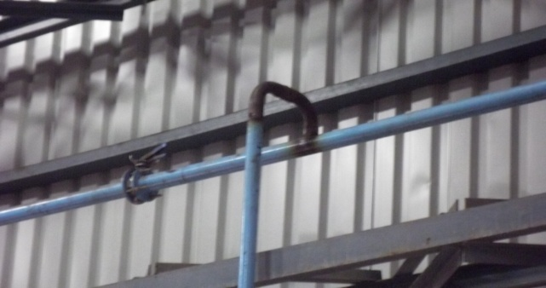
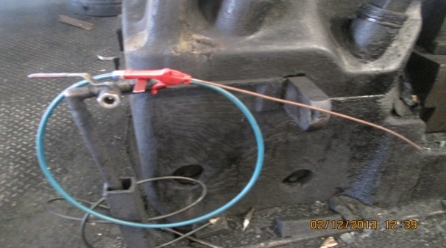
    Emission reduction from improving compressed air systems:
    -20-40% emission reduction due to implementation of the proposed BOP;
    -10 to 20% more could be generated by implementing Japanese hard technologies
Installation of new receiver and new air compressors (not inverter type)
Adjusting pressure setting
Reduce air leakage through installing foot switch
Reconsider pipe size and design
Start the use of efficient air gun

Slide 10
Examples of untapped potentials

Slide 11
What support is actually needed and which stakeholder(s) could/should provide it?
Financial capacity
Matching B2F is also required
Matching B2F and B2P is also required
Required project funding
e.g.: Install oil free inverter type air compressor
e.g.: Install several efficient standard air compressors
Maximum Own Capacity
e.g.: Install Inverter type oil injected air compressor
e.g.: Install one efficient standard air compressor
Matching B2B is sufficient
Matching B2P is also required
Technical capacity
Note:
B= Business
F= Finance
P= Policy/programme
Maximum Own Capacity
Required capacity through training programme

Slide 12
Key challenges to tap opportunities:
  High upfront cost of Japanese technologies;
  Significant information/knowledge gap exists: No comprehensive database on “seeds” and “needs” (technologies, financing options, stimulating policies, case studies, approximate prices, etc.)
  Incomplete, fragmented, and uncoordinated efforts among stakeholders to tap opportunities;
  Communication barriers (mindset, language, etc.).
>> It was concluded that there is a need to initiate a stakeholders' matchmaking platform to address all the above challenges in practical and systematic manner.

Slide 13
Initiating Japan-India Technology Matchmaking Platform (JITMAP)

Slide 14
Key feature of the platform
Bilateral: Specific focus on Japan and India;
Multistakeholder: Ensuring wider networking, knowledge & expertise, resources;
Practical: unique forum where matching B2B, B2F and B2P can occur on the ground as well as online in faster way;
Comprehensive: Information and knowledge sharing about various aspects (technologies data base, policies data base, financing options data base, etc). not just about one of them as in most existing platforms;
Systematic: It addresses all the stages of Technology Transfer process, with special focus given to follow up activities;
Ultimate goal is to materialize the opportunities rather than just identifying them; Develop information rather than just collect and share it;
It is not an alternative option to existing platforms, but rather a complementary one to them.

Slide 15
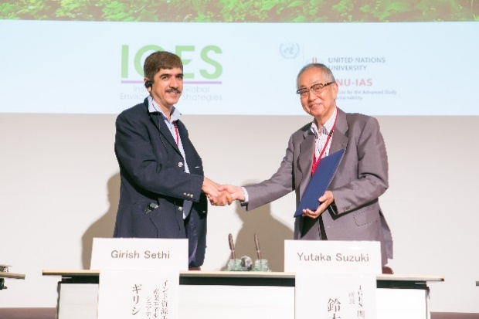
Japan-India Technology Matchmaking Platform (JITMAP)
JITMAP was initiated/launched as a trial basis on Jul. 13th, 2016. IGES and TERI as core members.
Leading Indian organizations has joined as dialogues members, namely: GEDA, MEDA, MCCIA, GITCO. Others are also expressing interests, from India and Japan.
Overall we think that JITMAP is working/operational given that:
-Actual emission reduction has been generated;
-Business opportunities have been created;
-Positive and encouraging feedbacks were received from Japanese private sector with whom we have been working. The involvement of Honda, Kobelco compressor, Bando chemical in FY2017 is well acknowledged.
Holding this Thematic Track, attended by high level representatives from Japan and India is and additional achievement under JITMAP. It is the best timing to launch the JITMAP website, which means to kick off the online matching as well.

Slide 16
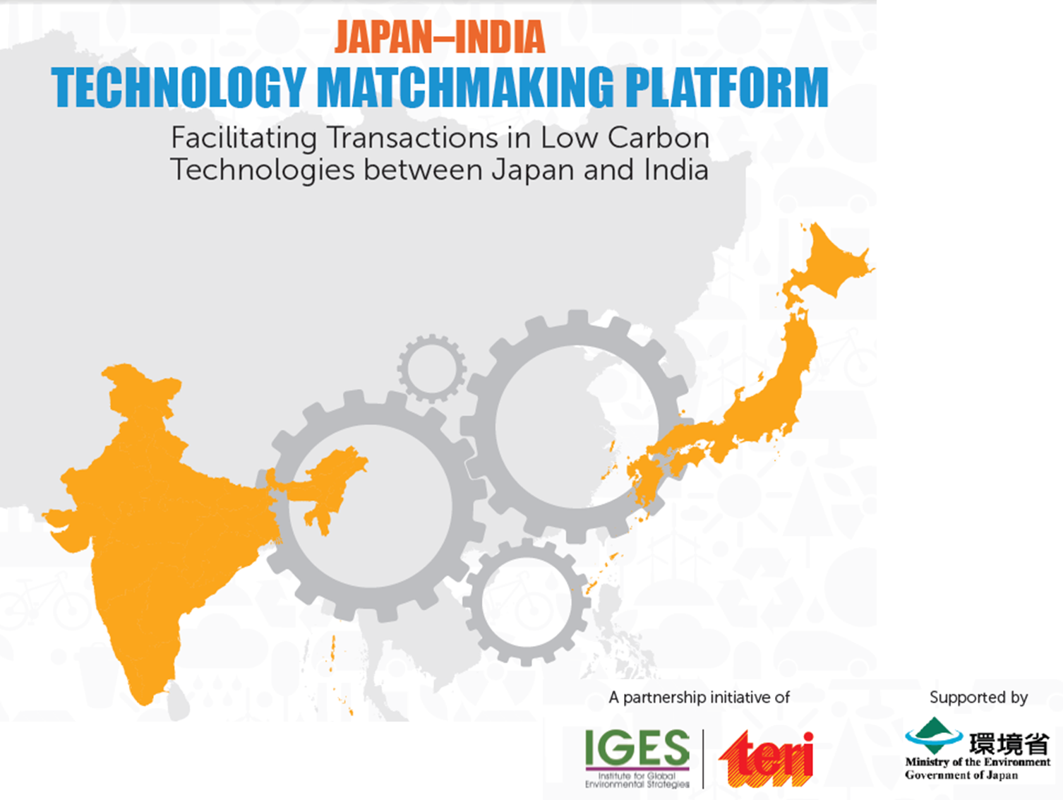
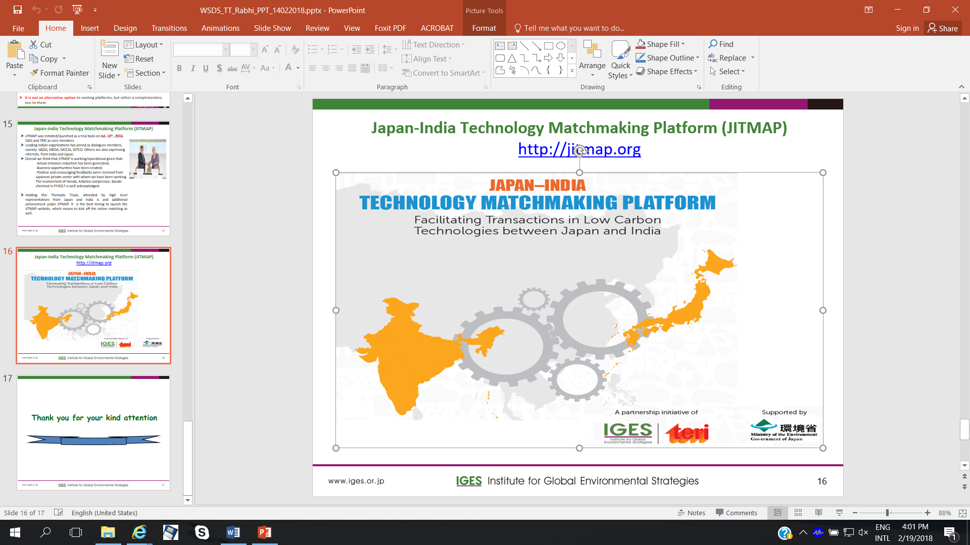
Japan-India Technology Matchmaking Platform (JITMAP)
http://jitmap.org

Slide 17
Thank you for your kind attention

