Slide 1
Development and Application of CCAC Emissions Quantification Tool Package for Solid Waste Sector
Matthew Hengesbaugh
Nirmala Menikpura
Premakumara Jagath Dickella Gamaralalage
Janya Sang Arun

Slide 2
Content
Part I: Introduction to tool package
Background
Objectives
Features of the tool
Input data requirements
Emission factors and default values
Emission results from individual technologies
Summary of the results
Part II: Application of the tool
Case study in Rayong-Thailand

Slide 3
Part 1: introduction to Tool Package

Slide 4
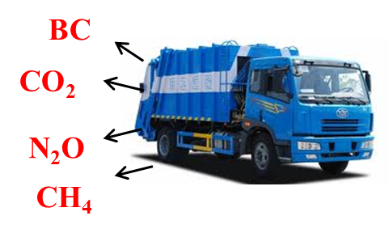
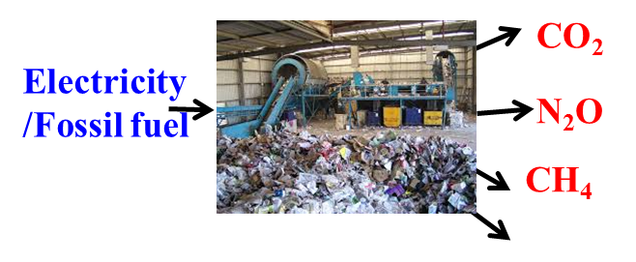
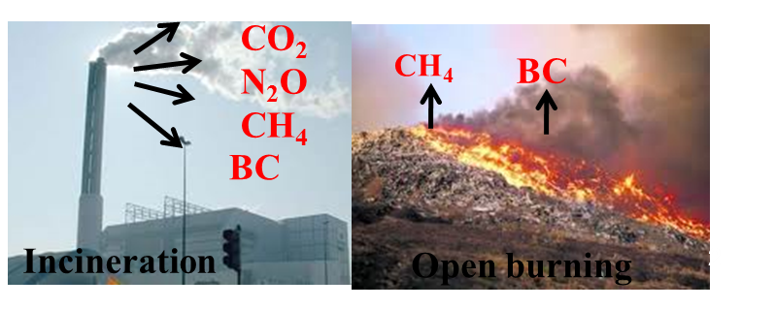
SLCPs and GHGs Emissions from MSW Management
All aspects of waste management activities emit GHGs and SLCPs
Waste Collection and transportation
Fossil fuel
Operational activities
BC
Electivity /fossil fuel
Treatment/final disposal
Cities need to undertake a rapid assessment of these emissions and identify suitable alternative solutions in order to develop climate friendly waste management systems
Notes:
-Greenhouse Gas (GHGs) and SLCPs (such as black carbon) emission from waste management activities, and its contribution to climate change is one of the critical environmental concerns.
-As shown in these pictures, each and every step of waste management emit both GHGs and SLCPs. Final disposal is the most critical stage, specially in developing countries, primary disposal methods like open dumping and landfilling create a substantial amount of methane emission.
-Therefore, cities need to undertake a rapid assessment of these emissions and identify suitable alternative solutions in order to develop climate friendly waste management systems.

Slide 5
Objectives: Emissions Quantification Tool
CCAC emission quantification tool
Decision making tool
User Manual
Monitoring tool
Undertake a rapid assessment of GHGs and SLCPs from BAU and compare with alternative solutions to find the most suitable options for the city.
Keep records and monitor the progress made on mitigating GHGs and SLCPs emissions from chosen waste management options
Notes:
Quantification of GHG and SLCP emissions from waste management is difficult task for personnel in local authorities level since they are not familiar with the procedures/methodologies of quantifications. Therefore, CCAC emission quantification tool is developed for facilitating both the decision making and monitoring purposes at city level
By using this tool ;
-Cities will be able to undertake a rapid assessment of the emissions (GHGs and SLCPs) from their current situation (business-as-usual) and identify suitable alternative solution(s)
-Cities will be able to compare the emissions from business-as-usual (BAU) scenario with alternative solutions and find the most suitable set of waste management practices
-Cities will be able to keep records and monitor their mitigation efforts from their waste management over time by using the monitoring and reporting module

Slide 6
Features of the Emission Quantification tool
This tool is simple and step-by-step guidance has been provided to users in all the sheets on how to enter the data and obtain the results
Special skill is not required and ability to work with MS Excel would be sufficient
Each and every sheet has designed a way that users can easily move among the sheets, enter the data and obtain the results on their preferred waste treatment options
Notes:
-Designing of user friendly interface was one of the key consideration in the process of development of the tool.
- User help has been given whenever the user feel difficulty on entering/choosing the required data
There are the specifications of this tool.
-This tool is very simple, and step by step guidance has been provided to users in all the sheets on how to enter the data and how to obtain the results
-Special skill is not required and ability to work with excel would be sufficient
-Each and every sheet has designed such a easy way that users can easily move among the sheets , enter the data and obtain the results on their preferred waste treatment options

Slide 7
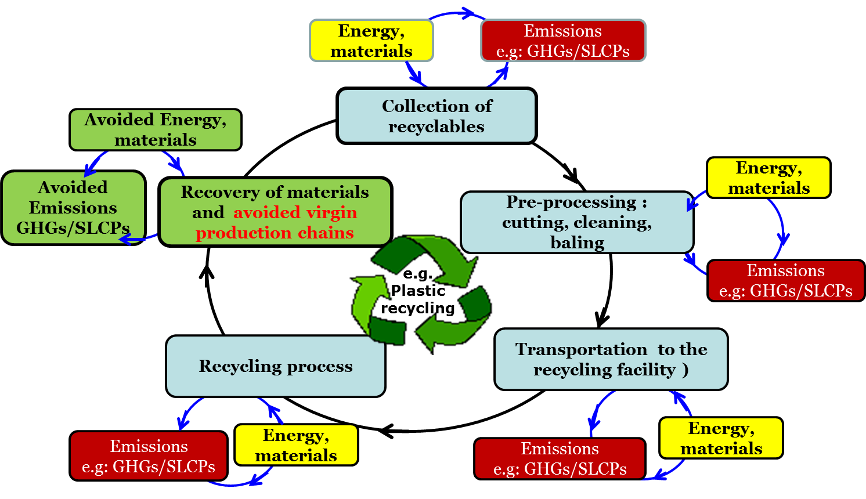
Accounting both GHGs and SLCPs from Life Cycle Assessment (LCA) Perspective
The tool accounts both SLCPs and other GHGs from waste management considering the entire life cycle
Collection and transportation
Pre-processing
Treatment
Final disposal
Both emissions and savings potentials are accounted across the life cycle
e.g: SLCPs and GHGs emissions and avoidance from different phases of life cycle of plastic recycling
Notes:
-Life cycle assessment has been used as the basis for development of this tool. Entire life cycle has been considered for accounting GHGs and SLCPs in the technologies. For example including collection, transportation, pre-processing, treatment and disposal
-Total direct GHG and SLCPs emissions account by accumulating emissions from all those phases. As a result of resource recovery from waste, there is a possibility for avoidance of emissions that would other wise occur through conventional material and energy production process. Therefore, potential savings of GHGs and SLCPs from avoided virgin production process chain displayed separately for users to understand the significance of resource recovery on emission reduction .
-Net emission is the key information that would utilized for the decision making process in order to choose the most appropriate waste management options. This tool will quantify the net climate impacts from individual treatment methods that would be useful for the decision making process, supporting cities in developing and planning climate friendly waste management systems

Slide 8
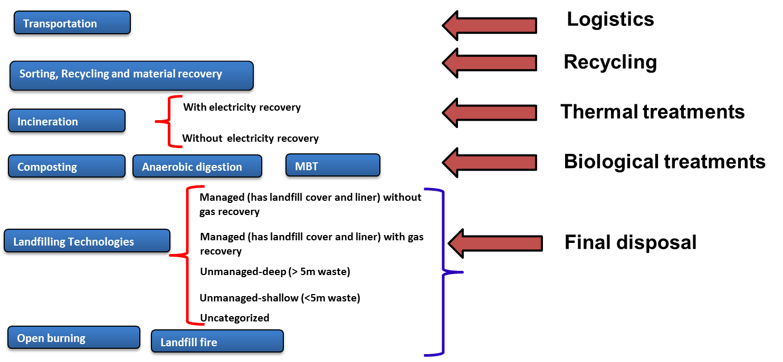
Geographical and Technology Coverage
This tool is designed to cover waste management systems in larger geographical area
Asia
Latin America
Africa
MENA
Other
Tool accounts the emissions from relatively basic waste management technologies to advanced technologies in both developing and developed countries
Notes:
- As far as geographical coverage is concerned, this tool is designed to cover waste management systems in larger geographical area which covers the CCAC member countries in Asia, Latin America, Africa, MENA, and others regions. You can see the list of countries in the “key data” sheets and more countries can be included into the list in the future.

Slide 9
Input Data Requirement
1. Key Data
2. Technology specific data
1. Key data: Country/location specific data e.g. basic data (geography, city population, climate zone, etc.), waste quantities/composition of generated waste, fuel consumption data/default emission factors, scenario specifications
Notes:
-The data requirement is the key element for quantifying the emissions from waste management by using this tool . Users are asked to enter the basic input data at city level and select the most appropriate conditions which are aligned with the waste-management practices of their local authority. Therefore, cities should record these data in a systematic way for quantifying GHGs and SLCPs emissions.
-Population of this city, location and climate zone, Waste quantities (generated and collected), Waste composition of generated waste, Waste treatment methods, waste composition used for individual treatment method, type and amount of fuel consumption for operational activities, amount of grid electricity consumptions, all the specifications related to materials and energy recovery rates. For instance, landfill gas capture rate and efficiencies of utilization of landfill gas, efficiencies of the engine etc should record and feed into the tool to quantify the net climate impact from sanitary landfill.
-Additional data such as country specific / region specific default values related to emissions, technological specifications have been provided in the tool by the developer

Slide 10
Input Data Requirement
2. Technology specific data: Users are asked to enter technology specific data (e.g. waste composition in each treatment, type and amount of fossil fuel used, amount of grid electricity used, amount of resources recovered and potential replacement of conventional resources)
Notes:
-The data requirement is the key element for quantifying the emissions from waste management by using this tool . Users are asked to enter the basic input data at city level and select the most appropriate conditions which are aligned with the waste-management practices of their local authority. Therefore, cities should record these data in a systematic way for quantifying GHGs and SLCPs emissions.
-Additional data such as country specific / region specific default values related to emissions, technological specifications have been provided in the tool by the developer

Slide 11
Emission Factors and Default Values
The option is given to the users to choose either location specific emissions factors or default values
e.g. grid emission factors, calorific values of the fuel, efficiencies of gas and electricity recovery, emission factors for avoided chemical fertilizer production
Institute for Energy and Environmental Research (IFEU) recommended emission factors for of BC and OC and their GWP values based on a literature review
BC and OC emission factors from different type of vehicles
Type of vehicle | g BC/kg fuel | g OC/ kg fuel | Source
Both modern and older trucks | 1.43 | 0.54 | IFEU recommended based on Bond et al. 2013 study
Modern trucks | 0.47 | 0.08
Older trucks | 2.39 | 1
BC and OC emission factors for open burning
 | BC (kg/tonne of waste ) | OC (kg/tonne of waste) | Source
Open burning and landfill file | 0.65 | 5.27 | IFEU recommended based on the mean value from Christian et al. 2010 study
GWP values of SLCPs and GHGs
Type of Gas | GWP20 | GWP100 | Source
CO₂ | 1 | 1 | IPCC (AR5), 2013
CH₄- biogenic | 84 | 28
CH₄-fossil | 85 | 30
N₂O | 264 | 265
BC | 2100 | 590 | IFEU recommended the value from Bond et al. 2013 study
Notes:
The developer tried to incorporate country/location specific data and default values as much as possible for more precise estimation.
In CCAC tool, I tried to develop more simpler interface where the user can enter the key specific data while they can either choose default values provided by the developer or enter the location specific emission factors. The tool has been designed such a way that user can either utilized the default values provided by the developer or they can enter the location specific values from their record.
This kind of user friendly approach has been designed for major causes for the emissions such as grid electricity factors, choosing the type of fossil fuel use for logistics and operational activities, energy content or the LHVs of fossil fuel, electrical and thermal net efficiency of energy generation and so forth. There are the major variables in the tool that make the significant impacts on the magnitude of emissions.

Slide 12
The results: Emissions of SLCPs and GHGs
SLCPs and GHGs emissions from individual treatment method will be disaggregated for each pollutant and presented per gas
GHGs and SLCPs emissions and avoided (as a result of resource recovery) potential is displayed
Net emissions (direct + indirect emissions – avoidance potential) are presented per gas
Net climate impact from BC and other GHGs shown separately
Notes:
-Once the data is entered, the interface will display results in a simple table format with respect to BAU and alternative scenarios
- The results table is easy to understand, and highlight magnitude of impacts with respect to type of gas and life cycle phase.
-Net emission of individual gas is also presented by subtracting emission avoidance potential from the direct and indirect emissions
-SLCPs and other GHGs has been separated for users to understand the significance of emissions with respect to different phases
-Finally net climate impact from each scenario will be displayed in terms of CO2-eq. please note that climate Impact from BC has been presented separately due uncertainties of BC emission factors

Slide 13
Summary of emissions
The summary sheet displays the summary of SLCPs and GHG emissions from BAU practice and alternative scenarios in both table and graph format
Notes:
-Once the user enter all the required data in the individual sheets with respect to the technologies of the BAU practice and intended scenarios, the overall results will be displayed in the summary sheet.
Before they pay attention on quantified emissions, they should check waste amount, waste composition data in the very first tables in the summary sheet. For instance Total treated waste amount in each scenario cannot be higher than total generation. Total treated waste amount should be more or less same in each scenario for making the comparison. Any dissimilarities can be easily noticed in the table as well as the graph. The tool will display the warning messages whenever such unusual situation has occurred, then the user should go back to the individual sheet and make the correction as appropriate.
Similarly, users should check the accuracy of the composition entered in each scenario. Composition of waste in each scenario should be more or less same for the comparison purpose. Whenever , dissimilarities have been occurred, the warning messages will be displayed and the users should go back to the individual sheet and correct them.
If all the criteria has been done nicely and if there is no any warning message in the summary sheet, and now they can look into the quantified GHGs and SLCPs emission results. In the summary table, net GHGs and SLCPs emissions will be displayed with respect to individual treatment methods as well as for all the scenario analyzed.
Net emission is the key information that would utilized for the decision making process in order to choose the most appropriate waste management options.
-For easy comparison propose, SLCPs and GHGs emissions from BAU practice and alternative scenarios will be displayed graphically. However if the cities face difficulties to understand the result, this interface can alter into a more simpler one.

Slide 14
Part 2: Practical application of The tool in a CITY case study

Slide 15
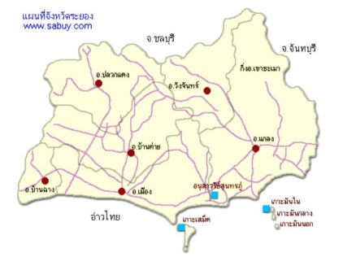
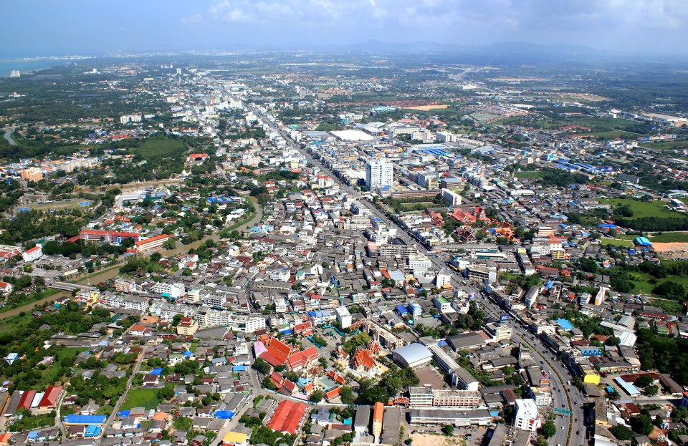
A case study : Rayong City- Thailand
Located in Rayong Province between the Ma Ta Phut Industrial Estate Zone and IRPC Industrial Park
Commerical, financial and education centre of Rayong Province
Total land area: 16.95 sq.km
Total population: 61,105
Total Households: 34,013
Population Density: 3,605

Slide 16
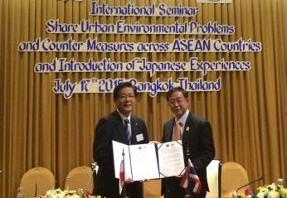
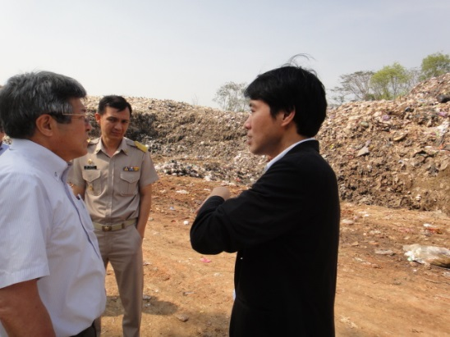
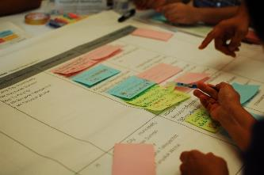
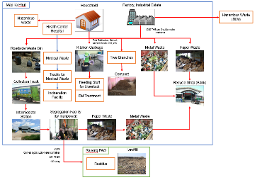
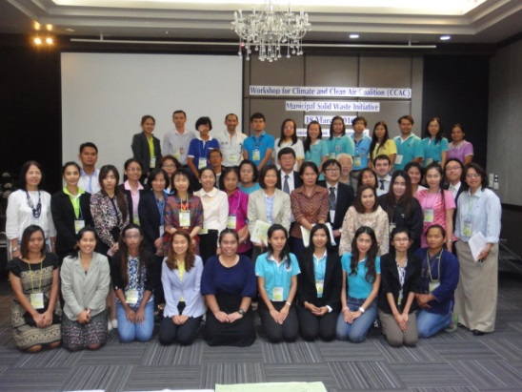
Capacity building for improving SLCP mitigation in MSWM sector
Project Partners
Financial and technical support
Implementation at local and national
levels
Project Implementation Process
Rapid city assessment
(2015/2016)
Development of action plan
(2015/2016)
Development of work plans and pilot implementation
Monitoring, documentation and expansion to other communities and cities
Current Project Status
Needs future support from CCAC
Notes:
IGES + Kitakyushu City involved in initial stages of financial and technical support under CCAC (city assessment, development of action plan)

Slide 17
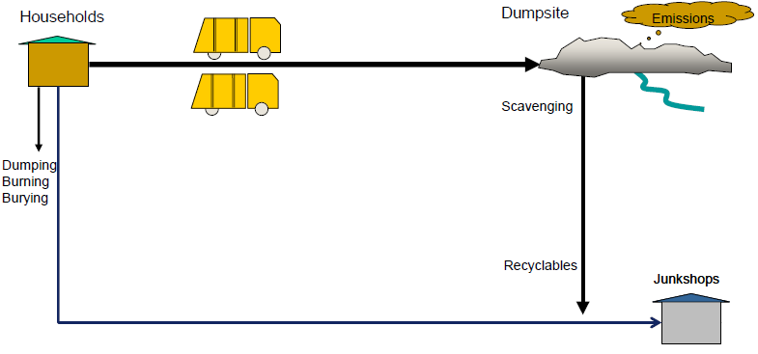
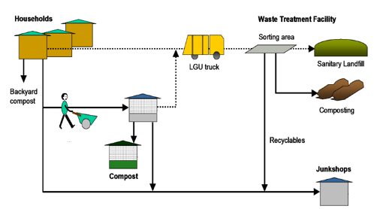
Strategic planning to mitigate SLCPs from MSWM
Current Practice of MSWM
Proposed strategy for MSWM
Waste Bank
Institutionalize waste separation at source and 3Rs
Promotion of Waste Bank integrating informal recycling activities
Promotion of composting for organic waste recycling
Closure the open dumping and transport the residual waste to sanitary landfill of the Rayong Province
Institutional and capacity building for the implementation of ISWM plan
Networking and city exchange among Kitakyushu, Rayong Province and Rayong City
Notes:
3 waste streams have been identified in Rayong City: organic, recyclables, and residual waste. The municipality plans to move towards transitioning from the open dump currently in operation and convert it to a public park. Rayong City intends to make use of the provincial sanitary landfill already in existence.

Slide 18
Application of the Tool
Decision making tool was used for a rapid assessment of current emissions resulting from business-as-usual-(BAU) practice of waste management in Rayong City.
Identified two alternative solutions for Rayong City from an emissions reduction perspective to compare with BAU practice.
BAU practice is mainly open dumping. Composting and recycling were identified as two potential resource recovery options.
Notes:
Disposal at sanitary landfill is without gas recovery systems.

Slide 19
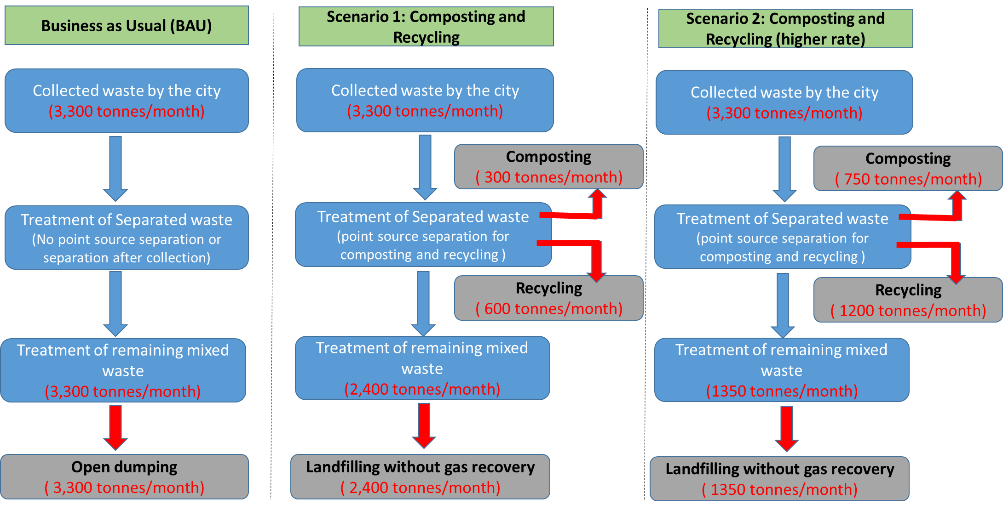
Comparison of BAU Practice with Two Alternative Scenarios

Slide 20
Entering Data into the Tool
Location specific data was used for more accurate estimations of the emissions
Basic Data

Slide 21
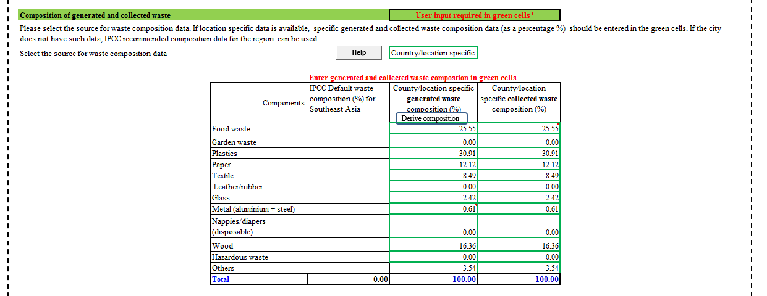
Entering Data into the Tool
Waste data

Slide 22
Estimated Results
An individual worksheet has been designed to estimate the technology specific emissions in consideration of their entire life cycle.
Emissions have been calculated per gas.

Slide 23
Estimated Results
The summary sheet indicates the overall results of the estimations in the Rayong city.
The aggregated net climate impact from two possible scenarios have been compared with BAU practices to select the most optimal waste management option for the city.

Slide 24
Estimated Results
Except BC, net emissions of other gases have been aggregated as CO₂-eq considering the Global Warming Potential (GWP) values of CO2, CH4, N2O .
GWP value of BC has not been finalised yet and therefore, net BC emissions from each scenario are shown separately.

Slide 25
Conclusions
The results of the case study proved that application of the tool can assist decision makers in selecting appropriate waste management strategies and technologies from an emissions reduction perspective.
However, other factors, such as institutional capacity, financial capability, and public acceptability of different treatment options should also be considered before making the final decision.
Climate impact from GHGs and SLCPs can be quantified with respect to individual treatments as well as an integrated system.
Further improvements need to be done in order to enhance user friendliness of the tool.
Some cities may make use of different types (i.e., more than one type) of landfill in BAU or future scenarios, such that incorporation of multiple landfill options in the same scenario is required.
Additional training and capacity building for city officials is required to support effective data collection and implementation of the tool.

Slide 26
Modifications are needed for a more robust estimation of BC
IFEU was engaged by IGES to provide BC emission factors as well as their Global Warming Potential (GWP)
Due lack of data availability on BC, IFEU provided only BC emissions from transportation and waste burning
However, BC emissions/avoidance from other technologies may be significant
Material recovery from recycling could significantly avoid BC emissions that would otherwise occur from virgin material production
Such estimations need to be done using indirect data/sources (e.g LCA inventories of virgin material production) for more robust estimations
Developers request additional time/budget to accomplish these tasks

Slide 27
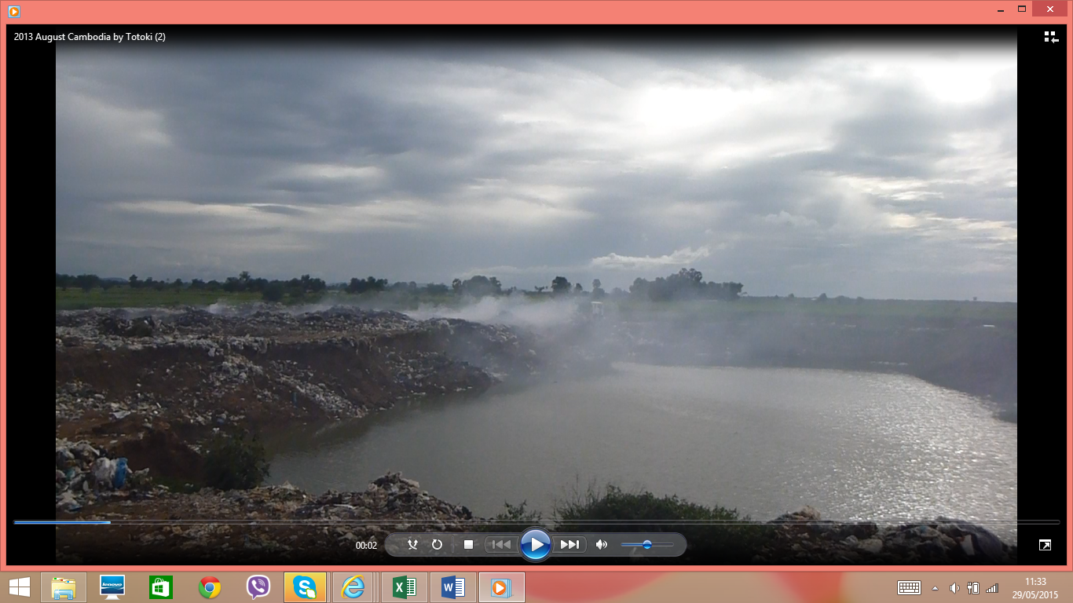
Thank you very much for your attention

