Slide 1
How to Foster Japan-MENA Countries’
Partnership towards NetZero Economies?
Dr. Abdessalem RABHI
Programme Manager
Institute for Global Environmental Strategies (IGES)

Slide 2
Why foster Japan-MENA NetZero Partnership?
Fact1. Readiness/commitments/willingness towards Just Energy Transition and resilient green growth
Among the pioneers in submitting and updating NDCs to the UNFCCC
Green Growth Strategies or plans in Place
Energy security and potential supply chain of green hydrogen for Japan, etc.
National mega projects
Fact2: Readiness/commitments/willingness to engage in bilateral and multilateral cooperation
Expression explicitly mentioned in the submitted NDCs
Japan Joint Crediting Mechanism (JCM) signed with Saudi Arabia, and MOU about it with Tunisia and UAE.
Saudi-Japan 2030 vision, etc.
Fact3. Building on the Momentum
1st and 2nd MENA Climate Week (UAE 2022 and KSA 2023, respectively)
TICAD8 (Tunisia 2022)
COP27 and COP28 (Egypt 2022 and UAE 2023, respectively)

Slide 3
Why foster Japan-MENA NetZero Partnership?
Target Audience |  | Issue | Communication Objective to Generate Impact | Key Message | KPI
MENA Stakeholders | Businesses Financing Agencies Policymakers Facilitators (Supporting agencies) | Scattered/limited information about Japanese enablers Difficult access to Japanese counterparts | Create awareness about green business opportunities Facilitate stakeholder matching to tap those opportunities | It is beneficial to adopt Japanese green technologies. It is beneficial to finance green projects. Many lessons to learn from Japanese policies toward Green Transition | GHG emission reduction amount Return on Investment (ROI) Number of MoU between stakeholders Number of implemented projects
Japan Stakeholders
Japan Stakeholders |  | Scattered/limited information about green business opportunities in MENA Difficult access to MENA counterparts |  | Facilitator’s role is crucial to promote Japan-MENA green business partnership It is beneficial to transfer technologies to MENA countries It is beneficial to finance Japanese green technologies to MENA countries Many lessons to share with MENA policymakers toward Green Transition

Slide 4
How to foster the Japan-North Africa NetZero Partnership?
IGES-IsDB-GRC Proposal: Green Business Matching Platform
e.g., Tunisia |  |  |  |  |  | Japan
Technological “Needs” |  | “Enablers” Database |  |  |  | Technological “Seeds” | “Enablers” Database
Sector | Sub-sector/Area | In-kind support | Financial support | Policy Support |  | Technologies & Best practices | In-kind Support | Financial Support | Policy Support
Energy Efficiency | Transport
 | Building
 | Industry | √ | √ | √ |  | 1, 2 ,3 ,4 ,5 ,7 | C, F, M, A, I | A, B, J | O, N, P
Renewable Energy | Wind
 | Solar
 | Biogas
 | Green Hydrogen
Waste | Solid waste
 | Wastewater
Water | Irrigation, Water desalination
Food & Agriculture | Organic/regenerative farming

Slide 5
How to foster the Japan-North Africa NetZero Partnership?
IGES-IsDB-GRC Proposal: Green Business Matching Platform (continue)
Support
Japanese
companies
Business to Business (B2B)
MENA companies
Market Research, Assessment & Analysis
Advisory/
Consultancy
Business Matching
(B2B, B2P, B2F)
Feasibility Studies
Human Resource Development
Knowledge Sharing & Information Service
Japanese Stakeholders
J-MENA GREEN
MENA Stakeholders
Businesses
Secretariat/Coordinators
Businesses
IGES
IsDB
Finance Providers
Finance Providers
Policymakers
Country Working Groups
Policymakers
Selected stakeholders from
Japan and MENA countries
Supporting Agencies
Supporting Agencies

Slide 6
Summary outline of the proposed J-MENA GREEN
Objectives | To promote a win-win Japan-MENA Countries’ Partnership towards NetZero Economy?
Examples of the expected activities | Knowledge sharing and information service Advisory/Consultancy Activities Network building and meetings facilitation (B2B, B2P, and B2F) Project development, implementation, and follow-ups Technical assistance and capacity building Outreach and dissemination events
Governance | IGES and IsDB as a Secretariat, supported by Country Working Groups (CWG)
Initially targeted countries | -Japan -Saudi Arabia, Egypt, Tunisia, and the United Arab Emirates (UAE)
Initial focus | Energy Efficiency and Renewable Energy (including waste to energy) in industry, building, transport, and agriculture sectors

Slide 7
Note: Phases 6~8 are conditional to the feasibility of the proposal and availability of resources.
Expected operation flow of J-MENA GREEN for businesses
Free
1) Access to Platform Website
2) If necessary, fill inquiry format and submit it to Secretariat
3) Receive a reply based on available data/Info.
5) Attend CWG meeting for proposal discussion
Paid
8) Engage the Secretariat in project implementation
7) Engage the Secretariat in project development
6) Engage the Secretariat in market assessment

Slide 8
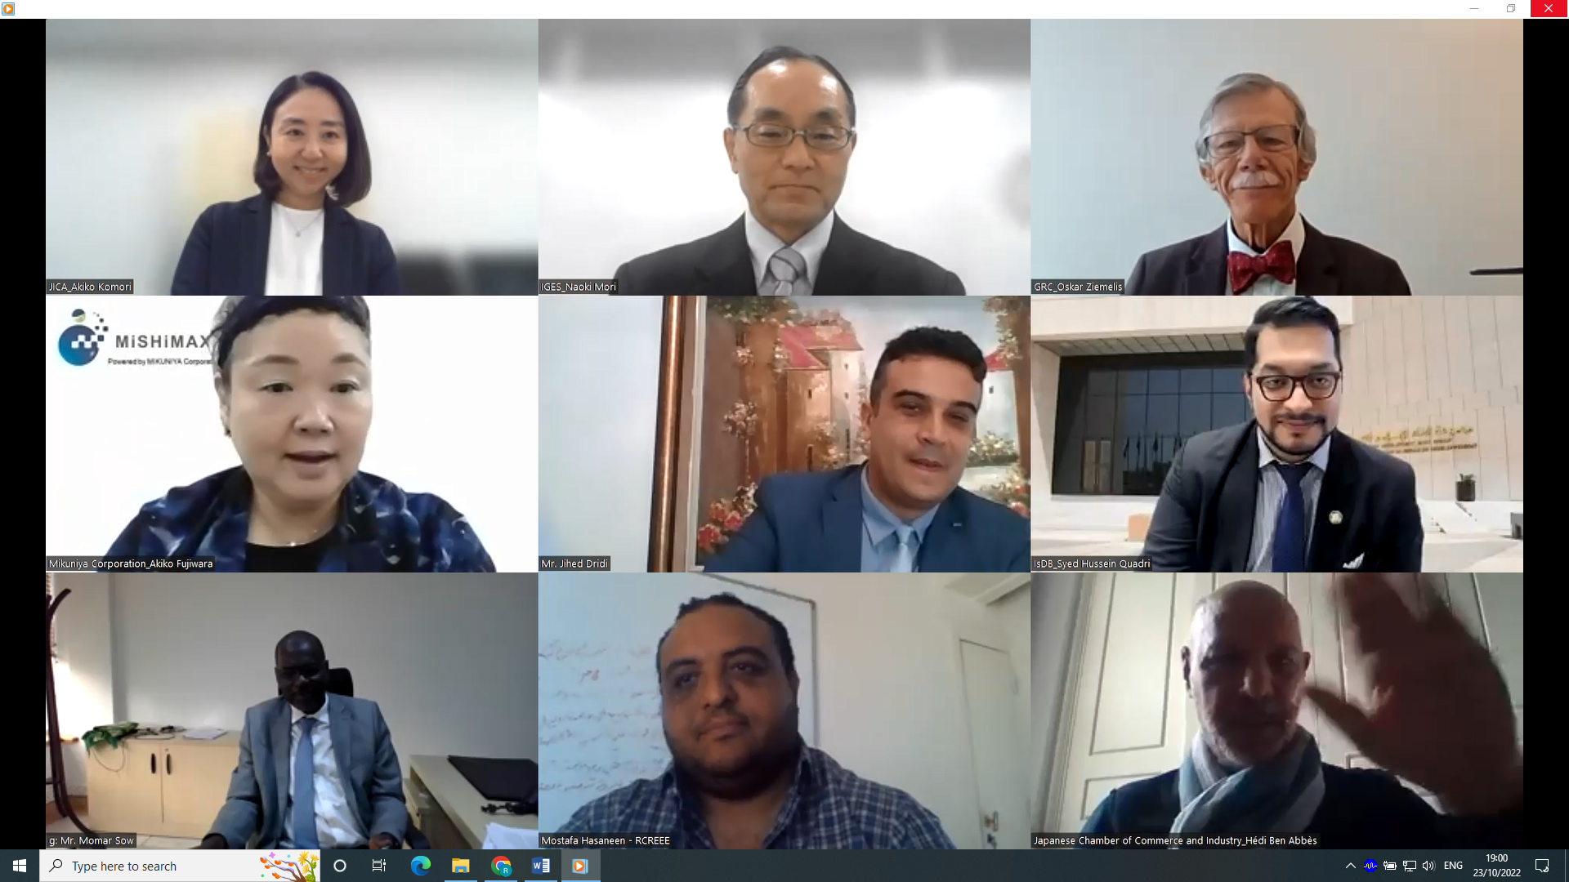
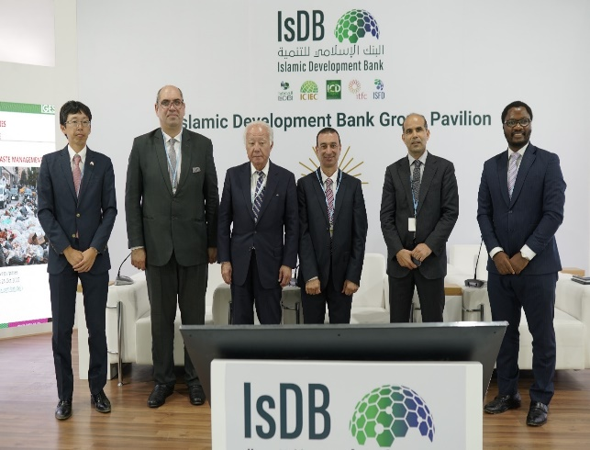
Way Forward & Next Steps
Preparation for launching the “Platform” (～12/2023)
Form Country Working Groups
Finalize the online content of the website
Key dissemination events
Side event @ MENA Climate Week (Saudi, Oct. 2022)
Launch the Website of the Platform @ COP28 (Dec. 2023).
Operation of the Platform (12/2023 ~06/2025)
Engage with stakeholders (online and on the ground)
Develop a business matching case(s), if possible
TICAD8, Tunisia (2022)
COP27, Egypt (2022)

Slide 9
Today’s Discussion objectives
Reaffirm the necessary and feasible to establish a Japan-MENA green business matching platform as one of the tools to foster a Win-Win NetZero partnership.
Gather inquiries or suggestions about or interests in engagement in the platform

Slide 10
Thank you for you attention

